Slide 1
WELL BEING (DOCTOR APPOINTMENT SYSTEM) Name: Poorva S P USN:4NM22IS407

Slide 2
INTRODUCTION
About the Company
About the project
How the project works

Slide 3
OBJECTIVE OF THIS PROJECT
Doctor appointment booking system is used to making easy for doctor and patient interaction.
In this project, between the doctor and patient conversation is going to through online. User not need to wait for booking appointment.
The main objective of this project is to develop a website for a medical clinic to provide an efficient and economical way of making appointments and help in all the related task.
In hospital doctor time table management, queue management and patient appointments exportations.
it is also required that doctors can easily see all the upcoming appointments and give the results to these appointments to the patients.

Slide 4
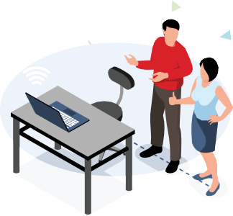
SOFTWARE AND HARDWARE REQUIREMENTS
HARDWARE REQUIREMENTS:
Processor : intel 3
Motherboard : intel 915gvsr chipset board
Ram : 4 gb ddr2 ram
Hard disk drive : 160 gb
SOFTWARE REQUIREMENTS:
Front end : html5, css3, bootstrap
Back end : php, mysql
PHP TOOLS:
xampp-win32-5.5.19-0-VC11

Slide 5
DISADVANTAGES OF EXISTING SYSTEM
It is time consuming​
It consumes lot of manpower to better results​
It lacks of data security​
Retrieval of data takes lot of time​
Percentage of accuracy is less​
Reports take time to produce

Slide 6
PROPOSED SYSTEM
User can search any doctor and book appointment as user prefer.
Key Features
Search Module
Appointment Booking
Check-in form Submitting
Appointment management
Schedule a timing
Past appointment Management
Ratings and Reviews

Slide 7
ADVANTAGES OF PROPOSED SYSTEM
The Project has several features and easy to manage.
1. The System is user friendly.
2. Cost effective.
3. Back up support.
4. Secured Data.

Slide 8
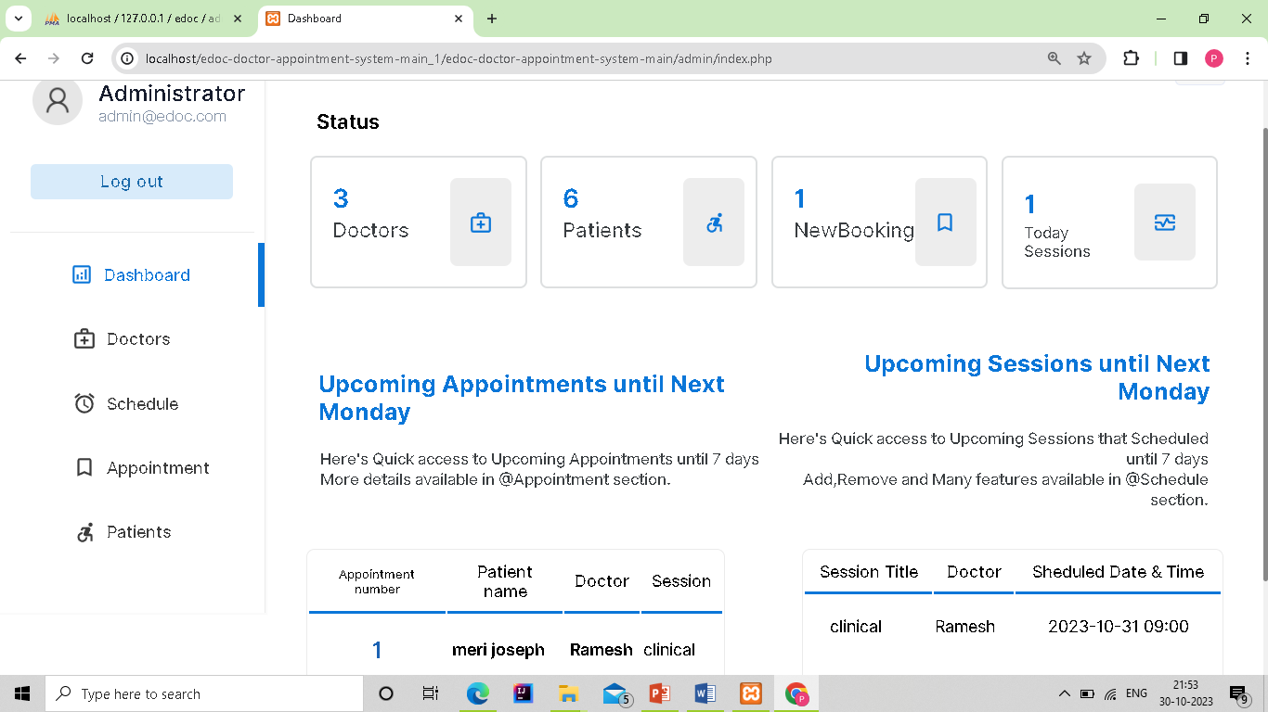
MODULE LIST
Admin Module
Login
Manage Doctors
View Doctors
Patients List
Appointment Details
Doctors Schedule
Queries
Fig 1.2:Admin Dashboard

Slide 9
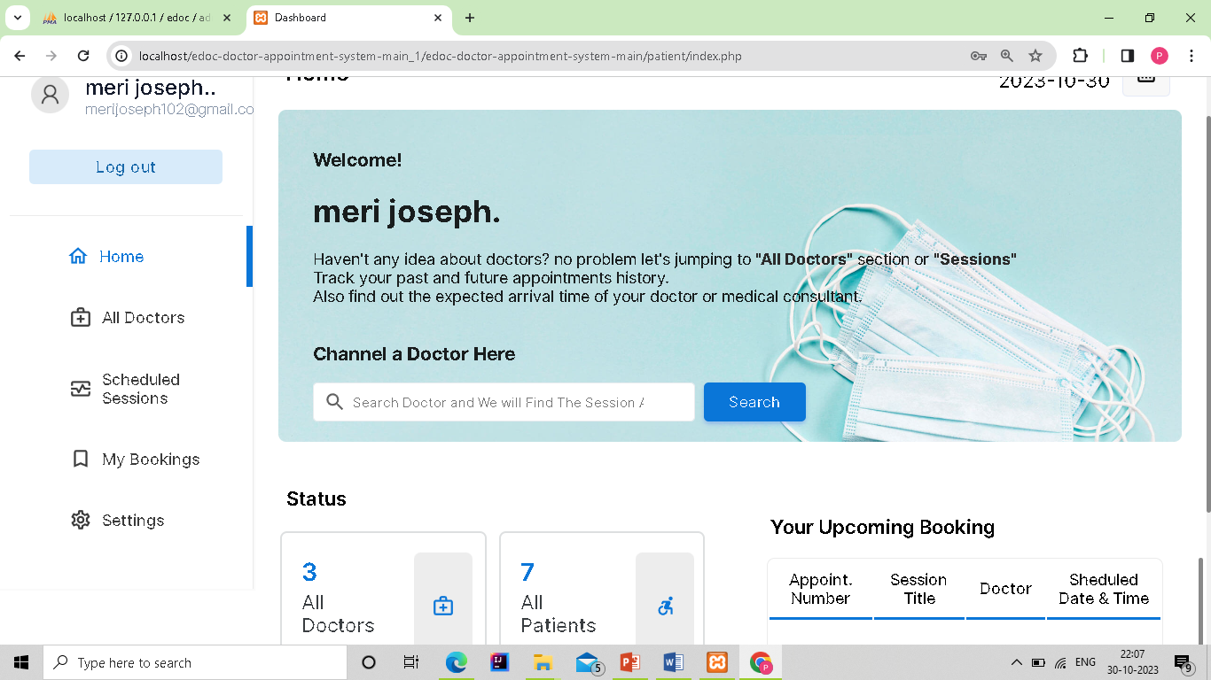
MODULE LIST
Patient Module
Login / Signup
Schedule Appointment
My Bookings
Doctor Module
Login
View Appointments
Make Schedule
Fig 1.2:Patient Dashboard

Slide 10
CONCLUSION
Prime lucidity that online appointment scheduling is attaining popularity every day is that it assists the patient to make appointments to different doctors or clinics in a much flexible manner.
It can be easily performed by using computers, accessing a software or website and making an appointment, rather than going to the hospital, waiting in a queue for longer hours only to make an appointment for the forthcoming weeks or months.
From this, patients can indulge in decisions made. Making an appointment to a doctor is made by nothing more than a click.

Slide 11
FUTURE ENHANCEMENT
In Future work, This application to develop a cross platforms like IOS, etc.
In adding the more features of doctor appointment booking management system to develop access with user’s flexibility.
To authenticate the users based on the system users list which is maintained by the operating system.
To restrict the usage of all files by the users based on their privileges on the system.

Slide 12
REFERNECES
https://www.mysqltutorial.org/
https://www.php.net/
https://www.w3schools.com/
https://stackoverflow.com/

Slide 13
THANK YOU

